Slide 1



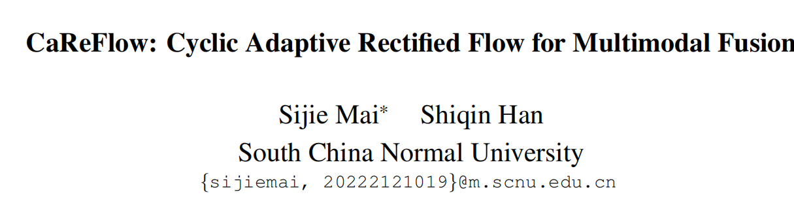



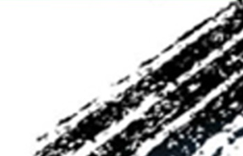

Chongqing University of Technology
ATAI
Advanced Technique of Artificial Intelligence
Chongqing University of Technology
—— CVPR 2026
Reported by ZhiWei Xu

Slide 2
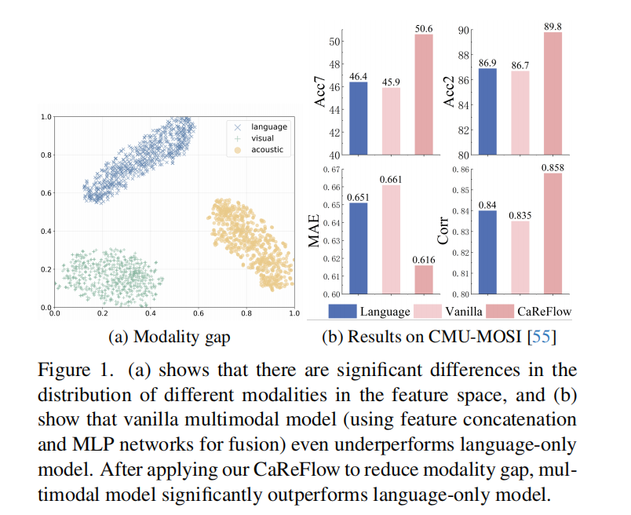
Motivation
1）However, a significant obstacle,known as the ‘modality gap’, severely impedes this fusion process . As shown in Fig. 1 (a), modality gap refers to the fundamental distributional discrepancy where data from different modalities reside in distinct, non-
aligned regions of the feature space due to the heteroge-
neous nature of different modalities and distinct feature ex-
tractors. Consequently, vanilla multimodal models struggle
to model their complex inter-dependencies, leading to sub-
optimal results and poor generalization .
2）They typically do not expose a data point of source modality to the ‘global distributional context’ of the target modality during modality alignment.This narrow view restricts the model’s ability to learn a holistic and robust modality alignment, especially when paired data is scarce.

Slide 3
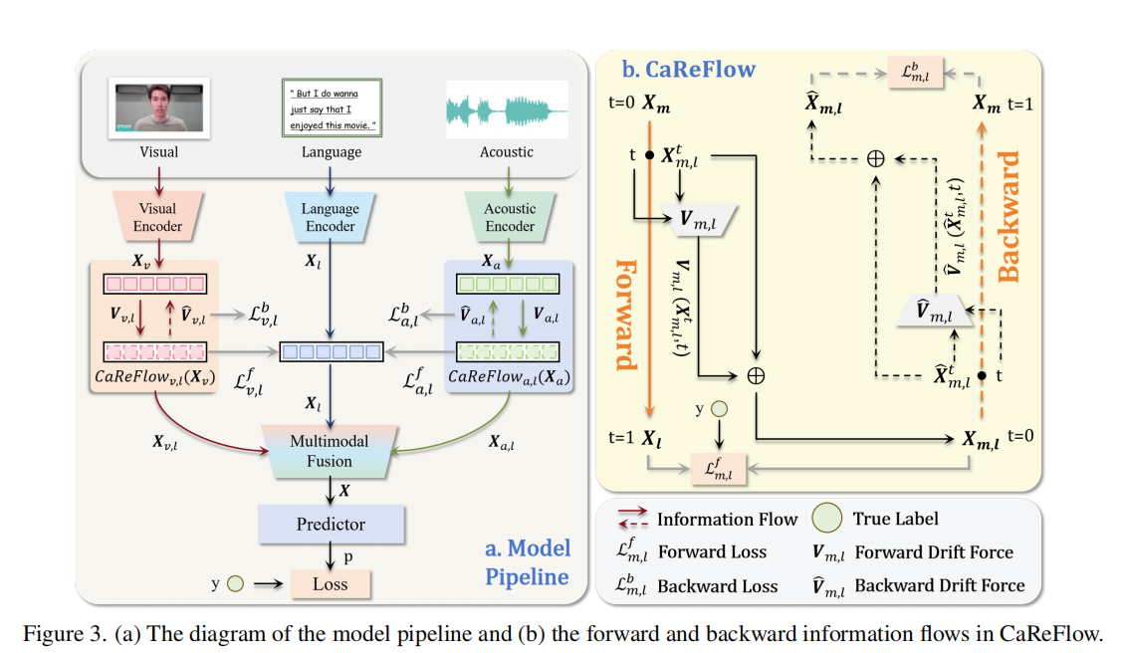
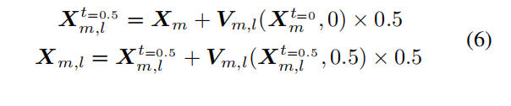
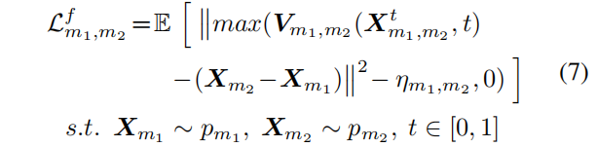
Method

Slide 4

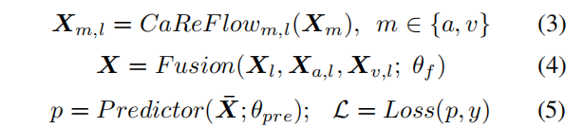
Method

Slide 5


Method

Slide 6
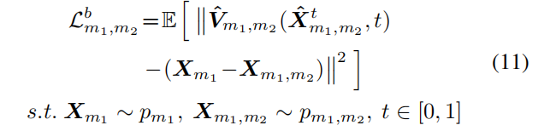

Method

Slide 7
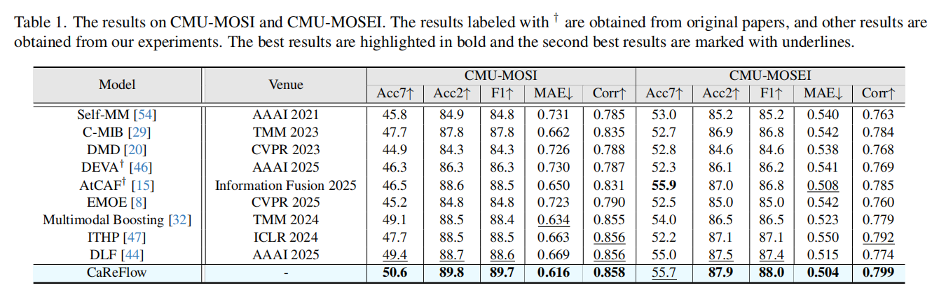
Experiments

Slide 8
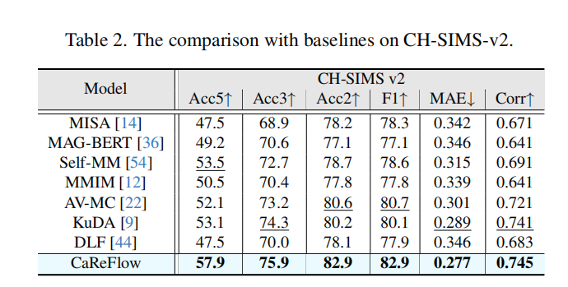
Experiments

Slide 9
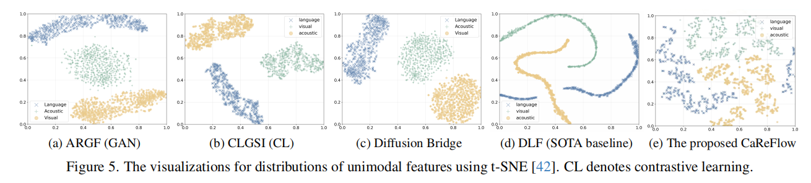
Experiments

Slide 10
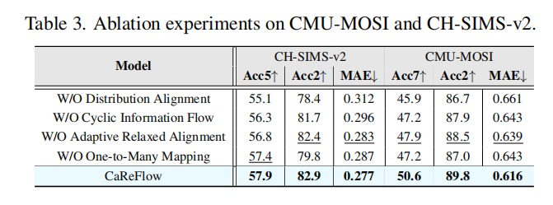
Experiments

Slide 11
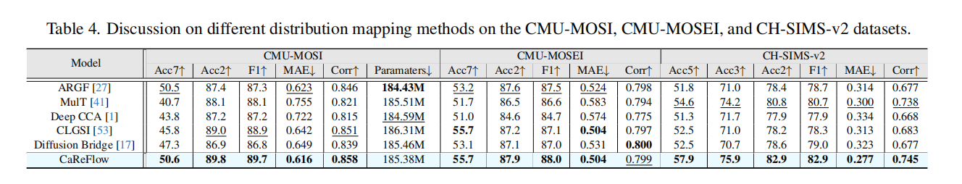
Experiments

Slide 12
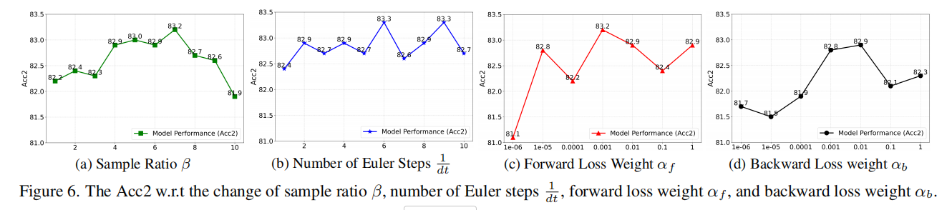
Experiments

Slide 13
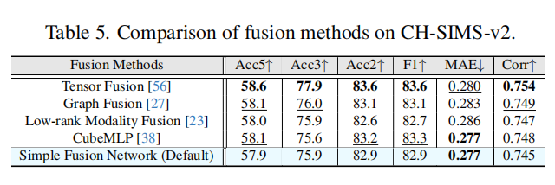
Experiments

Slide 14
Thanks!

